Slide 1
CHAPTER
17
Creating and Managing
Tables, Views, Indexes,
Clusters, and Sequences

Slide 2
Creating a Table
The columns in the TROUBLE table represent three major datatypes in Oracle—VARCHAR2, DATE, and NUMBER. Here is the SQL that created this Oracle table:
    create table TROUBLE (
    City VARCHAR2(13) NOT NULL,
    SampleDate DATE NOT NULL,
    Noon NUMBER(3,1),
    Midnight NUMBER(3,1),
    Precipitation NUMBER
    );

Slide 3
Creating a Table
These are the basic elements of this command:
      ■ The words create table
      ■ The name of the table
      ■ An opening parenthesis
      ■ Column definitions
      ■ A closing parenthesis
      ■ A SQL terminator

Slide 4
Creating a Table
The individual column definitions are separated by commas.
There is no comma after the last column definition.
The table and column names must start with a letter of the alphabet, but may include letters, numbers, and underscores. Names may be 1 to 30 characters in length, must be unique within the table, and cannot be an Oracle reserved word (see “Reserved Words” in the Alphabetical Reference of this book).

Slide 5
Creating a Table
If the names are not within double quotes, case does not matter in naming a table.
There are no options for DATE datatypes.
Varying-length character datatypes must have their maximum length specified.
NUMBERs may be either high precision (up to 38 digits) or specified precision, based on the maximum number of digits and the number of places allowed to the right of the decimal (an Amount field for U.S. currency, for instance, would have only two decimal places).

Slide 6
Creating a Table
NOTE
Do not enclose table and column names within double quotes; otherwise, case will matter.
This can be disastrous-terrible for your users or developers.

Slide 7
Character Width and NUMBER Precision
Specifying the maximum length for character (CHAR and VARCHAR2) columns and the precision for NUMBER columns has consequences that must be considered during the design of the table.
Improper decisions can be corrected later, using the alter table command, but the process can be difficult.

Slide 8
Character Width and NUMBER Precision
Deciding on a Proper Width
  A character column that is not wide enough for the data you want to put in it will cause an insert to fail and result in an error message:
      ERROR at line 1:
      ORA-12899: value too large for column "PRACTICE"."TROUBLE"."CITY"
      (actual: 16, maximum: 13)

Slide 9
Character Width and NUMBER Precision
The maximum width for CHAR (fixed-length) columns is 2,000 characters.
VARCHAR2 (varying length character) columns can have up to 4,000 characters.
In assigning width to a column, allot enough space to allow for all future possibilities.
A CHAR(15) for a city name, for instance, is just going to get you in trouble later on.
You’ll have to either alter the table or truncate or distort the names of some cities

Slide 10
Character Width and NUMBER Precision
NOTE
There is no penalty in Oracle for defining a wide VARCHAR2 column.
Oracle is clever enough not to store blank spaces at the end of VARCHAR2 columns.
The city name SAN FRANCISCO, for example,
will be stored in 13 spaces, even if you’ve defined the column as VARCHAR2(50 ).

Slide 11
Character Width and NUMBER Precision
NOTE
And if a column has nothing in it (NULL), Oracle will store nothing in the column, not even a blank space (it does store a couple of bytes of internal database control information, but this is unaffected by the size you specify for the column).
The only effect that choosing a higher number will have is in the default SQL*Plus column formatting.
SQL*Plus will create a default heading the same width as the VARCHAR2 definition.

Slide 12
Choosing NUMBER Precision
A NUMBER column with incorrect precision will have one of two consequences.
  Oracle will either reject the attempt to insert the row of data, or
  will drop some of the data’s precision.
Here are four rows of data about to be entered into Oracle:

Slide 13
Choosing NUMBER Precision
        insert into TROUBLE values
        ('PLEASANT LAKE','21-MAR-03',
        39.99, -1.31, 3.6);
        insert into TROUBLE values
        ('PLEASANT LAKE','22-JUN-03',
        101.44, 86.2, 1.63);
        insert into TROUBLE values
        ('PLEASANT LAKE','23-SEP-03',
        92.85, 79.6, 1.00003);
        insert into TROUBLE values
        ('PLEASANT LAKE','22-DEC-03',
        -17.445, -10.4, 2.4);

Slide 14
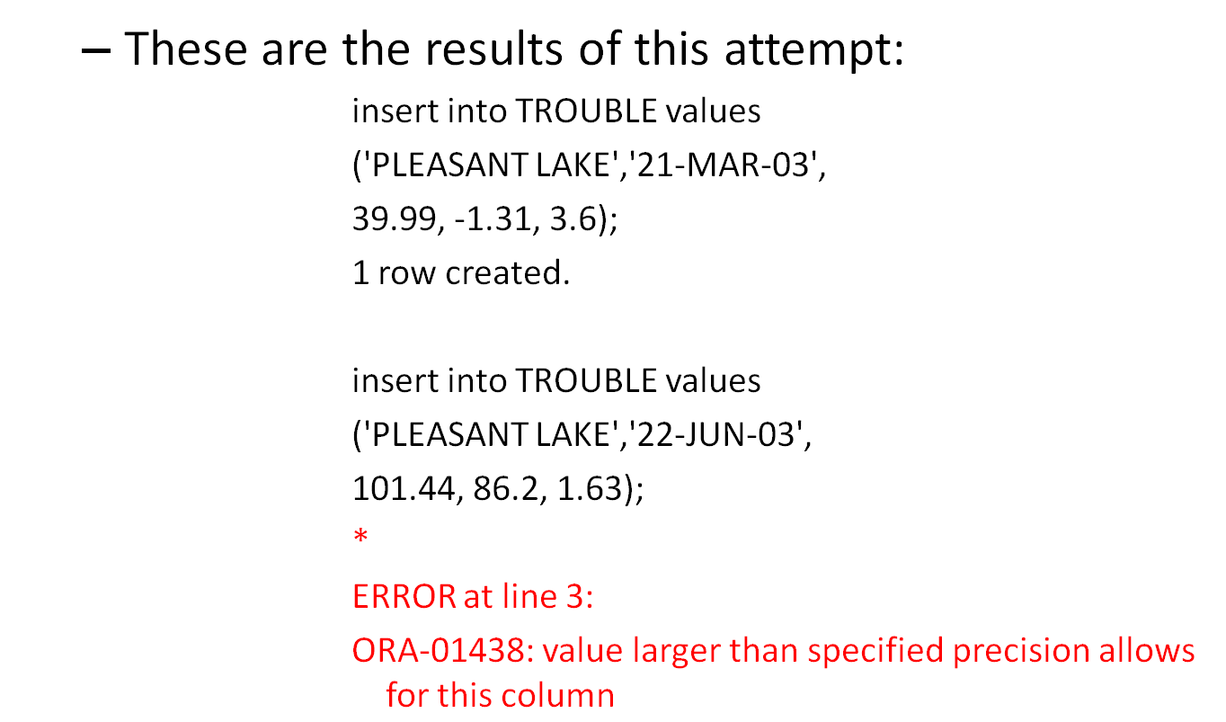
Choosing NUMBER Precision

Slide 15
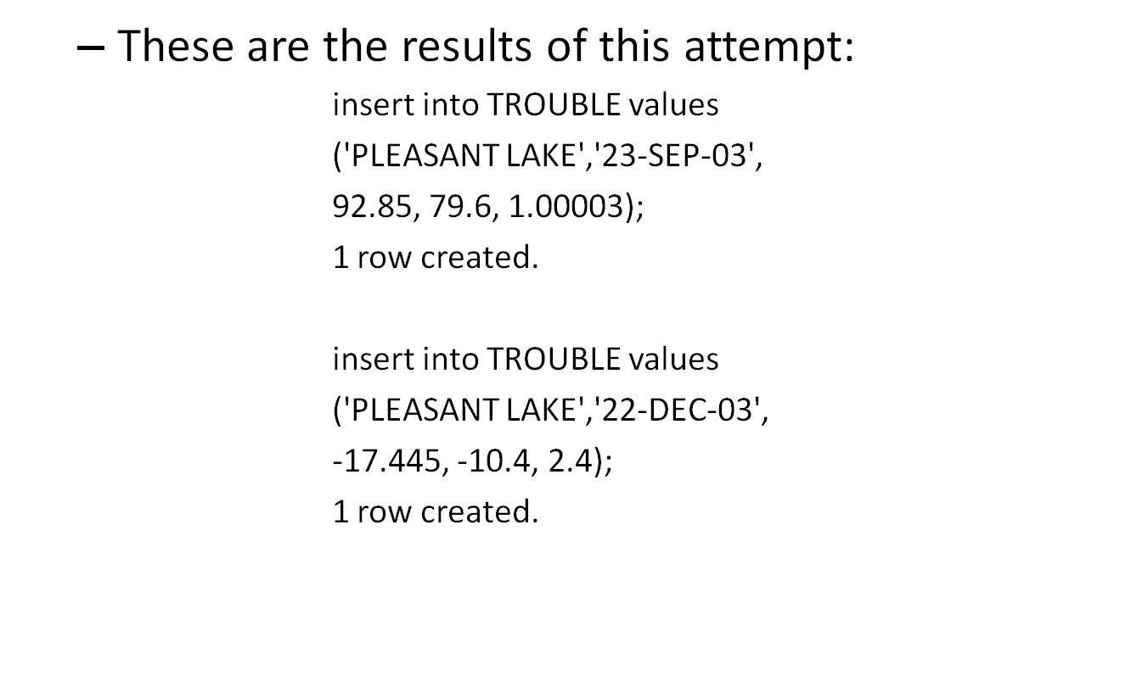
Choosing NUMBER Precision

Slide 16
Choosing NUMBER Precision
The first, third, and fourth rows were inserted, but the second insert failed because 101.44 exceeded the precision set in the create table statement, where Noon was defined as NUMBER(3,1).
The 3 here indicates the maximum number of digits Oracle will store.
The 1 means that one of those three digits is reserved for a position to the right of the decimal point.
Therefore, 12.3 would be a legitimate number, but 123.4 would not be.

Slide 17
Choosing NUMBER Precision
Note that the error here is caused by the 101, not the .44, because NUMBER(3,1) leaves only two positions available to the left of the decimal point.
The .44 will not cause the “value larger than specified precision” error.
It would simply be rounded to one decimal place.
This will be demonstrated shortly, but first, let’s look at the results of a query of the four rows we’ve attempted to insert:
select * from TROUBLE;

Slide 18
Choosing NUMBER Precision
The three rows were successfully inserted; only the problematic row is missing.
Oracle never inserted the single row for the insert statement that failed.

Slide 19
Rounding During Insertion
Suppose you correct the create table statement and increase the number of digits available for Noon and Midnight, as shown here:
        drop table TROUBLE;
        create table TROUBLE (
        City VARCHAR2(13) NOT NULL,
        SampleDate DATE NOT NULL,
        Noon NUMBER(4,1),
        Midnight NUMBER(4,1),
        Precipitation NUMBER
        );
Now the four insert statements will all be successful. A query now will reveal this:

Slide 20
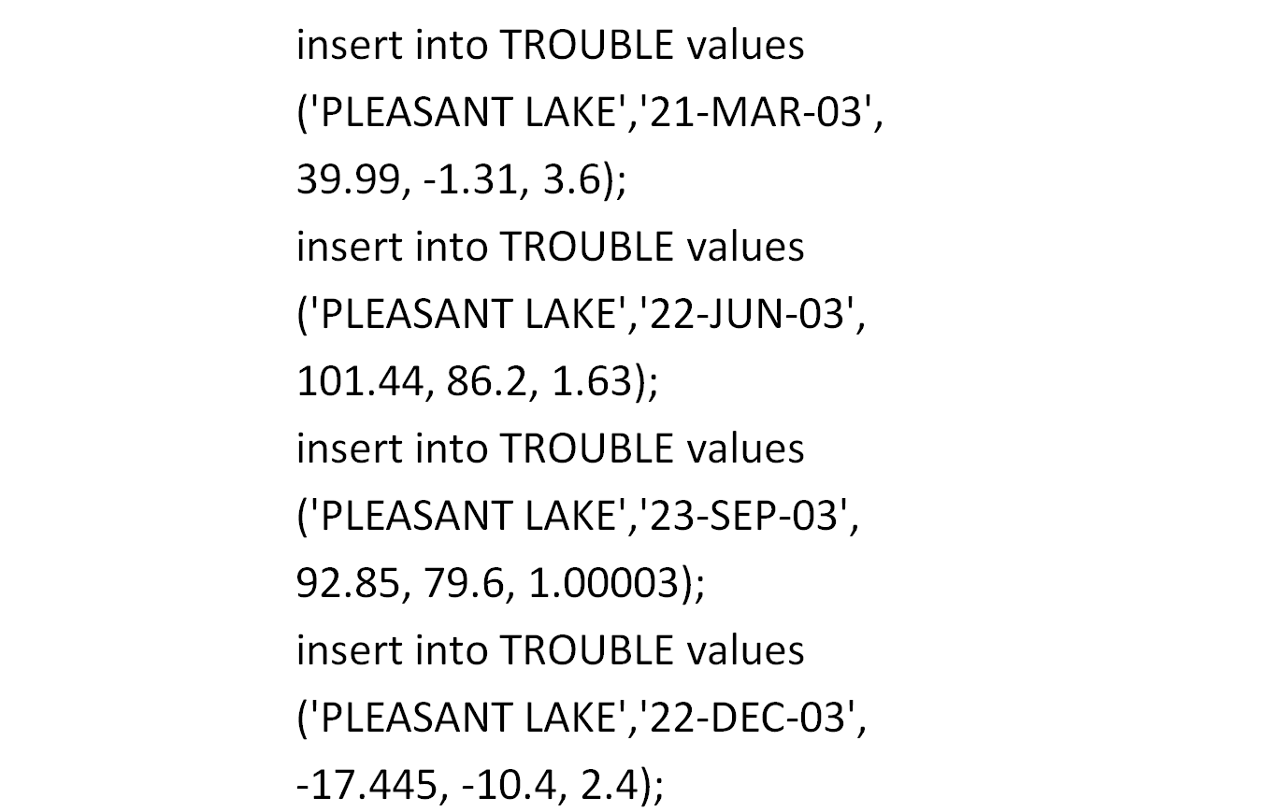
Rounding During Insertion

Slide 21
Rounding During Insertion
        select * from TROUBLE;
Look at the first insert statement. The value for Noon is 39.99. In the query, it is rounded to 40.
Midnight in the insert is –1.31. In the query it is –1.3. Oracle rounds the number based on the digit just to the right of the allowed precision.
Table 17-1 shows the effects of precision in several examples. See Chapter 9 for examples of the ROUND function.

Slide 22
TABLE 17-1. Effect of Precision on inserts

Slide 23
Constraints in create table
You can use the create table statement to enforce several different kinds of constraints on a table:
  candidate keys, primary keys, foreign keys, and check conditions.
  A constraint clause can constrain a single column or group of columns in a table.
  The point of these constraints is to get Oracle to do most of the work in maintaining the integrity of your database.
  The more constraints you add to a table definition, the less work you have to do in applications to maintain the data.
  On the other hand, the more constraints there are in a table, the longer it takes to update the data.

Slide 24
Constraints in create table
You can specify constraints in one of two ways: as part of the column definition (known as a column constraint) or at the end of the create table statement (known as a table constraint).
Clauses that constrain several columns must be table constraints.

Slide 25
The Candidate Key
A candidate key is a combination of one or more columns, the values of which uniquely identify each row of a table.
The following listing shows the creation of a UNIQUE constraint for the TROUBLE table

Slide 26
The Candidate Key
        drop table TROUBLE;
        create table TROUBLE (
        City VARCHAR2(13) NOT NULL,
        SampleDate DATE NOT NULL,
        Noon NUMBER(4,1),
        Midnight NUMBER(4,1),
        Precipitation NUMBER,
        constraint TROUBLE_UQ UNIQUE (City, SampleDate)
        );

Slide 27
The Candidate Key
The key of this table is the combination of City and SampleDate.
Notice that both columns are also declared to be NOT NULL.
This feature requires you to specify values for certain columns in order for rows to be inserted.
Clearly, temperature and precipitation information is not useful without knowing where or when it was collected

Slide 28
The Candidate Key
This technique is common for columns that are the primary key of a table, but it’s also useful if certain columns are critical for the row of data to be meaningful.
If NOT NULL isn’t specified, the column can have NULL values.
When you create a UNIQUE constraint, Oracle will create a unique index to enforce the uniqueness of the values.

Slide 29
The Primary Key
The primary key of a table is one of the candidate keys that you give some special characteristics.
You can have only one primary key, and a primary key column cannot contain NULLs.
The following create table statement has the same effect as the previous one, except that you can have several UNIQUE constraints but only one PRIMARY KEY constraint:

Slide 30
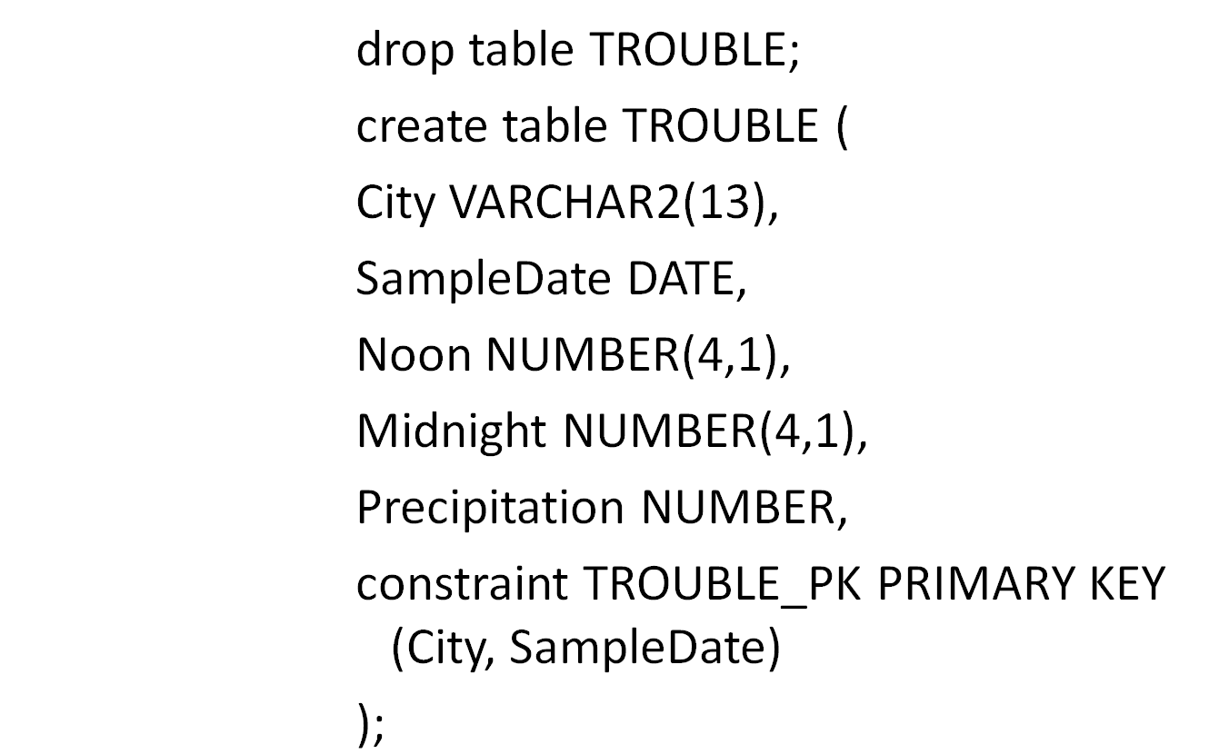
The Primary Key

Slide 31
The Primary Key
For single-column primary or candidate keys, you can define the key on the column with a column constraint instead of a table constraint:
    create table AUTHOR
    (AuthorName VARCHAR2(50) primary key,
    Comments VARCHAR2(100));

Slide 32
The Primary Key
In this case, the AuthorName column is the primary key, and Oracle will generate a name for the PRIMARY KEY constraint.
This is not recommended if you want to enforce a common naming standard for keys, as discussed later in “Naming Constraints.”

Slide 33
The Foreign Key
A foreign key is a combination of columns with values based on the primary key values from another table.
A foreign key constraint, also known as a referential integrity constraint, specifies that the values of the foreign key correspond to actual values of the primary key in the other table.
In the BOOKSHELF table, for example, the CategoryName column refers to values for the CategoryName column in the CATEGORY table:

Slide 34
The Foreign Key
    create table BOOKSHELF
    (Title VARCHAR2(100) primary key,
    Publisher VARCHAR2(20),
    CategoryName VARCHAR2(20),
    Rating VARCHAR2(2),
    constraint CATFK foreign key (CategoryName)
    references CATEGORY(CategoryName));

Slide 35
The Foreign Key
You can refer to a primary or unique key, even in the same table.
However, you can’t refer to a table in a remote database in the references clause.
You can use the table form (which is used earlier to create a PRIMARY KEY on the TROUBLE table) instead of the column form to specify foreign keys with multiple columns.

Slide 36
The CHECK Constraint
Many columns must have values that are within a certain range or that satisfy certain conditions.
With a CHECK constraint, you can specify an expression that must always be true for every row in the table.
For example, the RATING table stores the valid ratings; to limit the available values beyond the limits enforced by the column definition, you can use a CHECK constraint, as shown in the following listing:

Slide 37
The CHECK Constraint
  create table RATING_WITH_CHECK
  (Rating VARCHAR2(2) CHECK (Rating <= 9),
  RatingDescription VARCHAR2(50));
  26/09/13

Slide 38
Naming Constraints
You can name your constraints.
If you use an effective naming scheme for your constraint names,you will be better able to identify and manage the constraints.
The name of a constraint should identify the table it acts upon and the type of constraint it represents. For example, the primary key on the TROUBLE table could be named TROUBLE_PK.

Slide 39
Naming Constraints
You can specify a name for a constraint when you create the constraint.
If you do not specify a name for the constraint, Oracle will generate a name.
Most of Oracle’s generated constraint names are of the form SYS_C###### (for example, SYS_C000145).
Because the system-generated constraint name does not tell you anything about the table or the constraint, you should name your constraints.

Slide 40
Naming Constraints
In the following example, the PRIMARY KEY constraint is created, and named, as part of the create table command for the TROUBLE table (notice the constraint clause):
        create table TROUBLE (
        City VARCHAR2(13),
        SampleDate DATE,
        Noon NUMBER(4,1),
        Midnight NUMBER(4,1),
        Precipitation NUMBER,
        constraint TROUBLE_PK PRIMARY KEY (City, SampleDate)
        );

Slide 41
Naming Constraints
The constraint clause of the create table command names the constraint (in this case, TROUBLE_PK).
You may use this constraint name later when enabling or disabling constraints.

Slide 42
Dropping Tables
Dropping tables is very simple.
You use the words drop table and the table name, as shown here:
      drop table TROUBLE;
You drop a table only when you no longer need it.
In Oracle, the truncate command lets you remove all the rows in the table and reclaim the space for other uses without removing the table definition from the database.

Slide 43
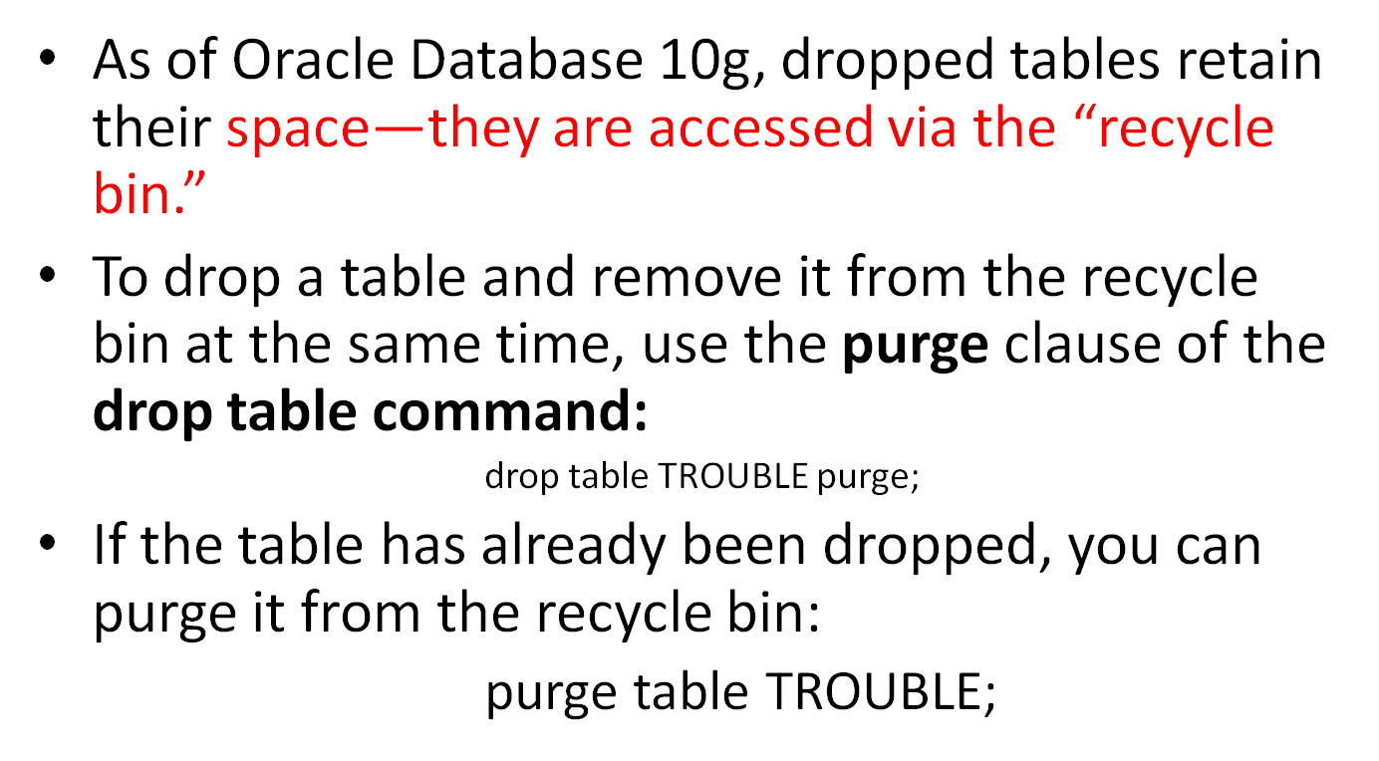
Dropping Tables

Slide 44
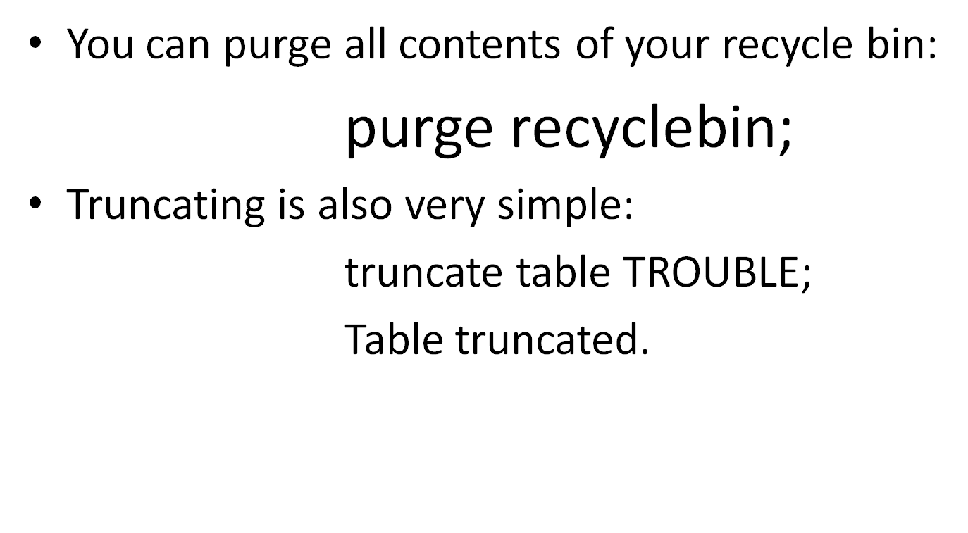
Dropping Tables

Slide 45
Dropping Tables
Truncating can’t be rolled back.
If there are triggers that delete rows that depend on rows in the table, truncating does not execute those triggers.
You should be sure you really want to truncate before doing it.
You can choose to release the table’s storage (via the drop storage clause, the default) or to retain it (via reuse storage).

Slide 46
Altering Tables
Table definitions can be altered in several ways:
  by adding a column to an existing table,
  By changing a column’s definition, or
  by dropping a column.
  DBAs commonly alter tables in other ways to manage space and memory usage.
Adding a column is straightforward, and this process is similar to creating a table.
Suppose you decide to add two new columns to the TROUBLE table:
Condition, which you believe should be NOT NULL, and Wind, for the wind speed.
The first attempt starts by creating the table and populating it with a few records:

Slide 47
Altering Tables
Table definitions can be altered in several ways:
  by adding a column to an existing table,
  By changing a column’s definition, or
  by dropping a column.
  DBAs commonly alter tables in other ways to manage space and memory usage.
Adding a column is straightforward, and this process is similar to creating a table.
Suppose you decide to add two new columns to the TROUBLE table:
Condition, which you believe should be NOT NULL, and Wind, for the wind speed.
The first attempt starts by creating the table and populating it with a few records:

Slide 48
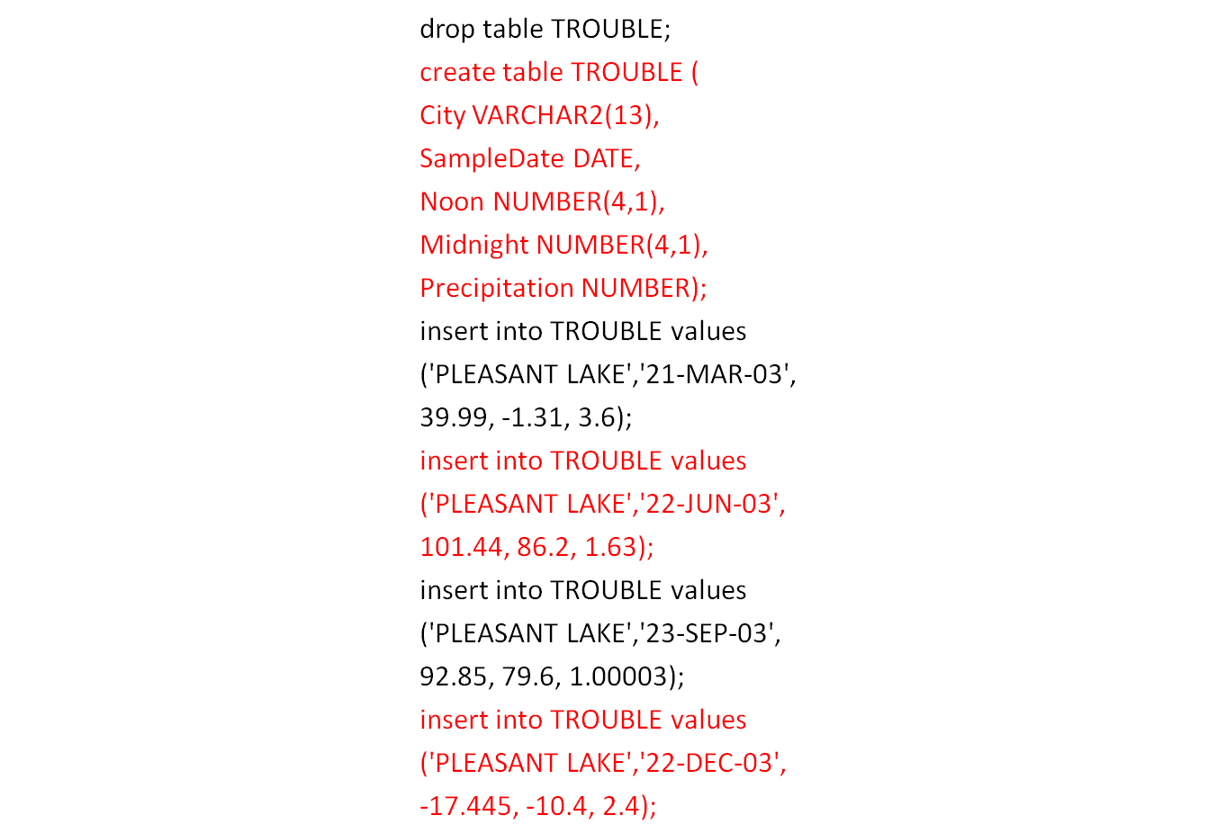
Altering Tables

Slide 49
Altering Tables
The first attempt at adding the new columns looks like this:
      alter table TROUBLE add (
      Condition VARCHAR2(9) NOT NULL,
      Wind NUMBER(3)
      );
      alter table TROUBLE add (
      *
      ERROR at line 1: ORA-01758: table must be empty to add
      mandatory (NOT NULL) column

Slide 50
Altering Tables
You get an error message because you cannot add a column defined as NOT NULL—when you try to add it, the column won’t have anything in it.
Each row in the table would have a new empty column defined as NOT NULL.
The alter table command’s add clause will work with a NOT NULL column if the table is empty,
but usually it is impractical to empty a table of all its rows just to add a NOT NULL column.

Slide 51
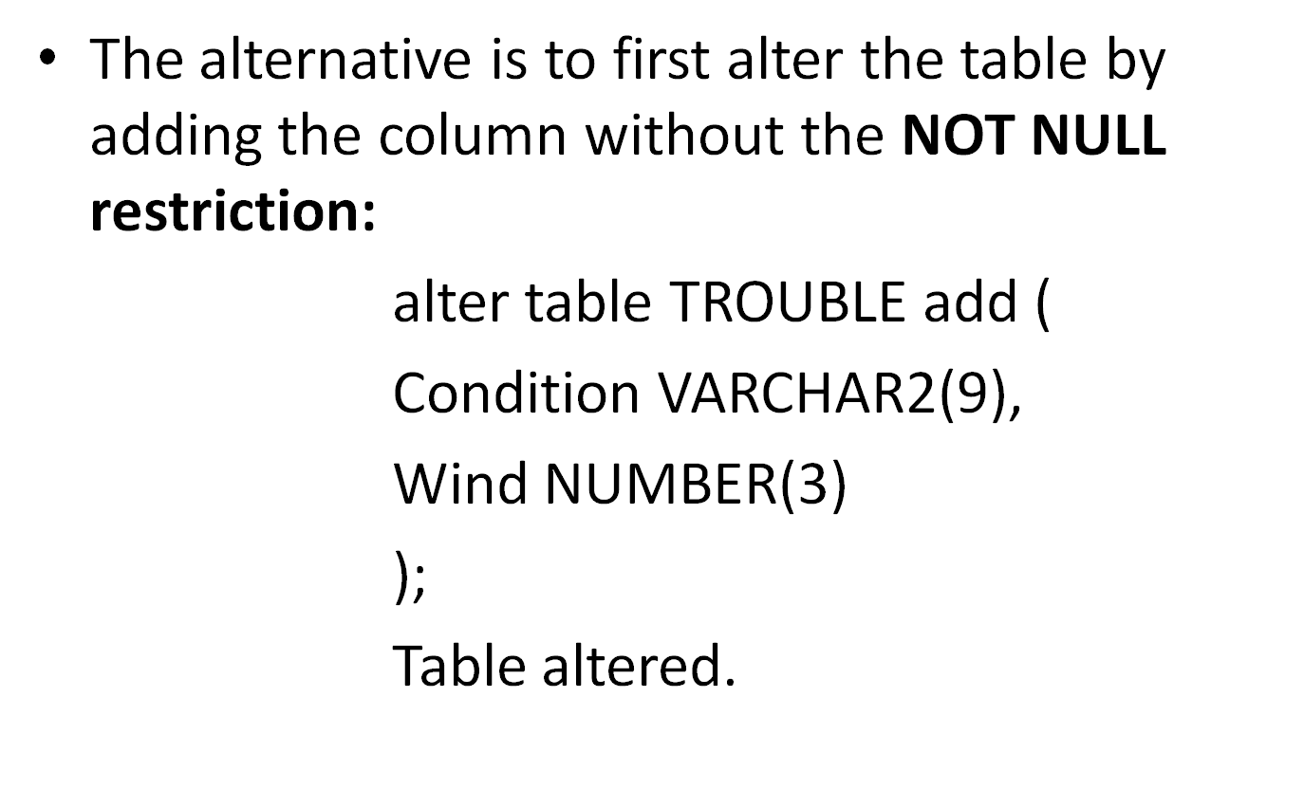
Altering Tables

Slide 52
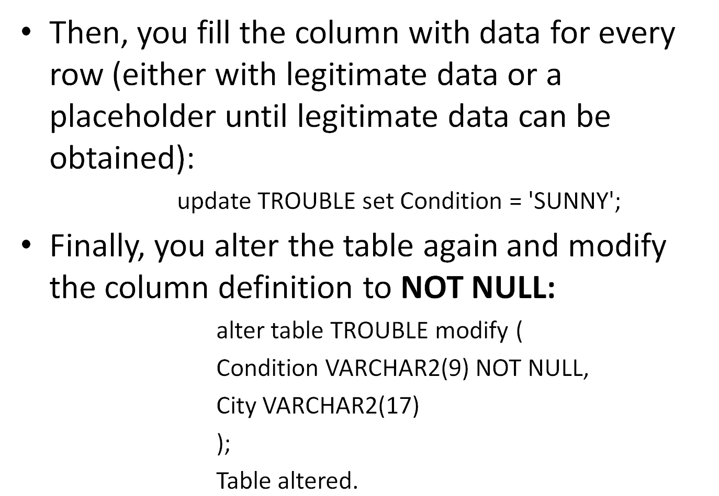
Altering Tables

Slide 53
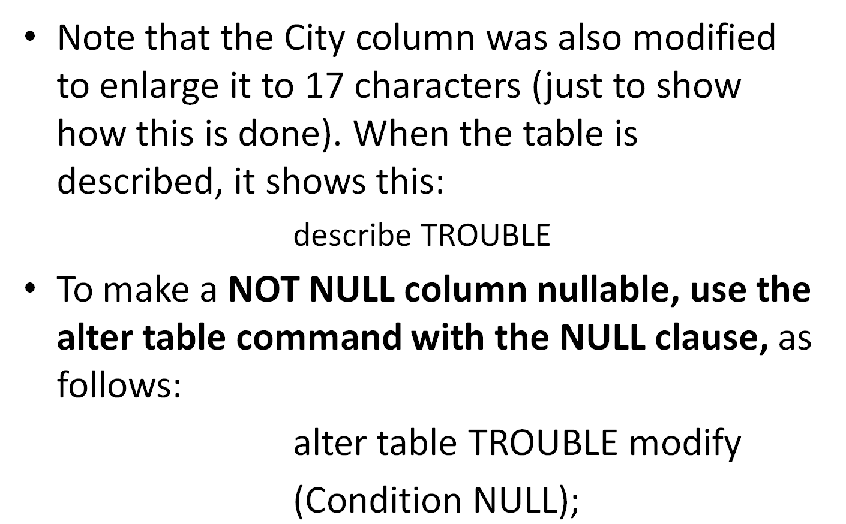
Altering Tables

Slide 54
The Rules for Adding or Modifying a Column
These are the rules for adding a column to a table:
■ You may add a column at any time if NOT NULL isn’t specified.
■ You may add a NOT NULL column in three steps:
    1. Add the column without NOT NULL specified.
    2. Fill that column with data for every row.
    3. Modify the column to be NOT NULL

Slide 55
The Rules for Adding or Modifying a Column
NOTE
If you use the default clause when adding a column, Oracle will update each row with that default value when it adds the column;
these updates fire any AFTER UPDATE triggers defined on the table
(see Chapter 30).

Slide 56
The Rules for Adding or Modifying a Column
These are the rules for modifying a column:
  ■ You can increase a character column’s width at any time.
  ■ You can increase the number of digits in a NUMBER column at any time.
  ■ You can increase or decrease the number of decimal places in a NUMBER column at any time.

Slide 57
The Rules for Adding or Modifying a Column
In addition, if a column is NULL for every row of the table, you can make any of these changes:
■ You can change the column’s datatype.
■ You can decrease a character column’s width.
■ You can decrease the number of digits in a NUMBER column.

Slide 58
Dropping a Column
You can drop a column from a table.
Dropping a column is more complicated than adding or modifying a column because of the additional work that Oracle has to do.
Just removing the column from the list of columns in the table—so it doesn’t show up when you select * from the table—is easy.
It’s recovering the space that was actually taken up by the column values that is more complex, and potentially very time-consuming for the database.

Slide 59
Dropping a Column
For this reason, you can drop a column immediately or you can mark it as “unused,” to be dropped at a later time.
If the column is dropped immediately, the action may impact performance.
If the column is marked as unused, there will be no impact on performance.
The column can actually be dropped at a later time when the database is less heavily used.

Slide 60
Dropping a Column
To drop a column, use either the set unused clause or the drop clause of the alter table command.
You cannot drop a pseudo-column, a column of a nested table, or a partition key column.
In the following example, column Wind is dropped from the TROUBLE table:

Slide 61
Dropping a Column
    alter table TROUBLE drop column Wind;
Alternatively, you can mark the Wind column as unused:
    alter table TROUBLE set unused column Wind;
Marking a column as “unused” does not release the space previously used by the column, until you drop the unused columns:
    alter table TROUBLE drop unused columns;

Slide 62
Dropping a Column
You can query USER_UNUSED_COL_TABS, ALL_UNUSED_COL_TABS, and DBA_UNUSED_ COL_TABS to see all tables with columns marked as unused.
NOTE
Once you have marked a column as “unused,” you cannot access that column.

Slide 63
Dropping a Column
You can drop multiple columns in a single command, as shown in the following listing:
    alter table TROUBLE drop (Condition, Wind);
NOTE
When dropping multiple columns, you should not use the column keyword of the alter table command; it causes a syntax error.
The multiple column names must be enclosed in parentheses, as shown in the preceding listing.

Slide 64
Dropping a Column
If the dropped columns are part of primary keys or unique constraints, you will need to also use the cascade constraints clause as part of your alter table command.
If you drop a column that belongs to a primary key, Oracle will drop both the column and the primary key index.

Slide 65
Creating a Table from a Table
Oracle lets you create a new table on-the-fly, based on a select statement on an existing table:
        create table RAIN_TABLE as
        select City, Precipitation
        from TROUBLE;
        Table created.
NOTE
The create table … as select … command will not work if one of the selected columns uses the LONG datatype.

Slide 66
Creating a Table from a Table
When the new table is described, it reveals that it has “inherited” its column definitions from the TROUBLE table.
A table created in this fashion can include all columns, using an asterisk if you like, or a subset of columns from another table.
It also can include “invented” columns, which are the product of functions or the combination of other columns, just as in a view.

Slide 67
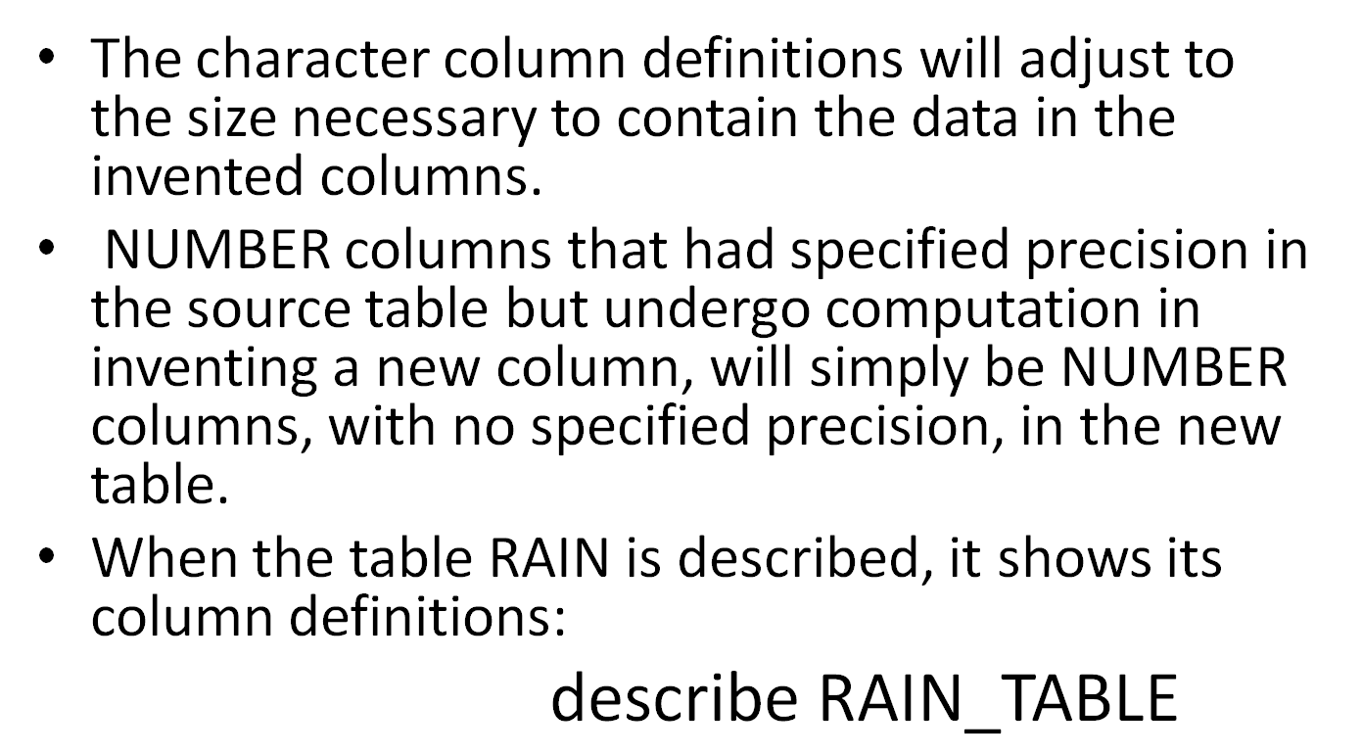
Creating a Table from a Table

Slide 68
Creating an Index-Organized Table
An index-organized table keeps its data sorted according to the primary key column values for the table.
An index-organized table stores its data as if the entire table was stored in an index.
Indexes serve two main purposes:

Slide 69
Creating an Index-Organized Table
■ To enforce uniqueness When a PRIMARY KEY or UNIQUE constraint is created, Oracle creates an index to enforce the uniqueness of the indexed columns.
■ To improve performance When a query can use an index, the performance of the query may dramatically improve.
See Chapter 43 for details on the conditions under which a query may use an index.

Slide 70
Creating an Index-Organized Table
An index-organized table allows you to store its entire data in an index.
A normal index only stores the indexed columns; an index-organized table stores all its columns in the index.
To create an index-organized table, use the organization index clause of the create table command, as shown in the following example:

Slide 71
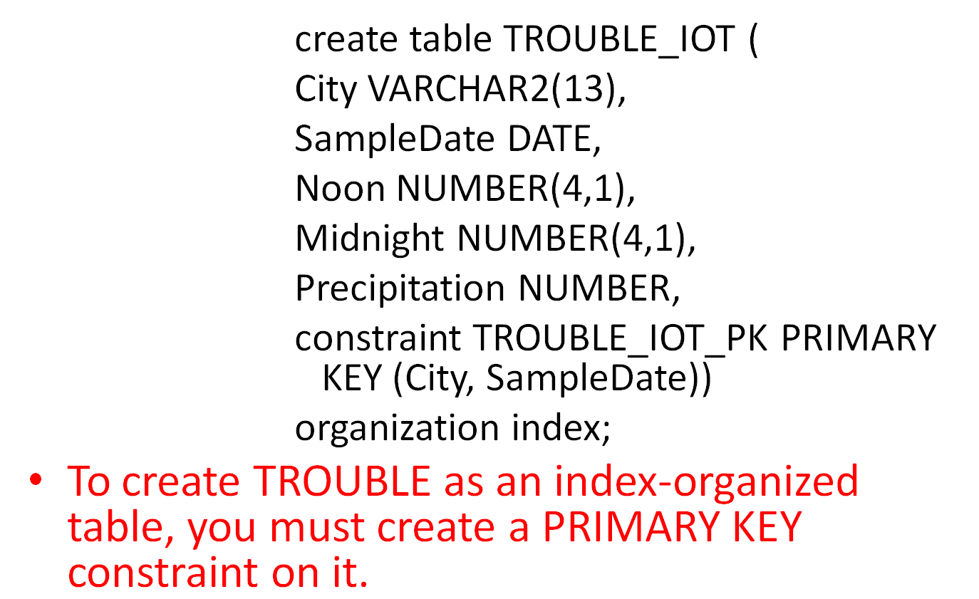
Creating an Index-Organized Table

Slide 72
Creating an Index-Organized Table
An index-organized table is appropriate if you will always be accessing the TROUBLE data by the City and SampleDate columns (in the where clauses of your queries).
To minimize the amount of active management of the index required, you should use an index-organized table only if the table’s data is very static.
If the table’s data changes frequently, you should use a regular table with indexes as appropriate.

Slide 73
Creating an Index-Organized Table
In general, an index-organized table is most effective when the primary key constitutes a large part of the table’s columns.
If the table contains many frequently accessed columns that are not part of the primary key, the index-organized table will need to repeatedly access its overflow area.
Despite this drawback, you may choose to use index-organized tables to take advantage of a key feature that is not available with standard tables: the ability to use the move online option of the alter table command.

